Slide 1
Food Sufficiency and Obesity
Sophia Harris, Sam McFarland, Esal Shakil, and Nika Yermakova

Slide 2
Our Datasets: Obesity
This dataset was published by the Centers for Disease Control and Prevention.
It includes data on adult’s diet, physical activity, and weight status from Behavioral Risk Factor Surveillance System.
It provides specific data on obesity, nutrition, and physical activity.
There was both state-by-state and national data.
The data spanned from 2011-2022.

Slide 3
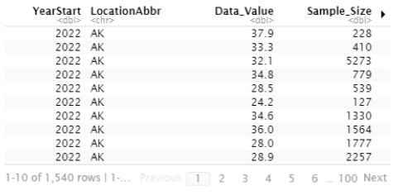
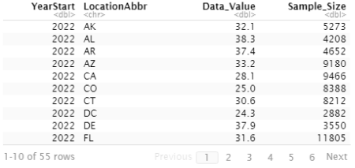
Our Datasets: Obesity
We started with the data looking like this:
And we tidied it up to look like this:

Slide 4
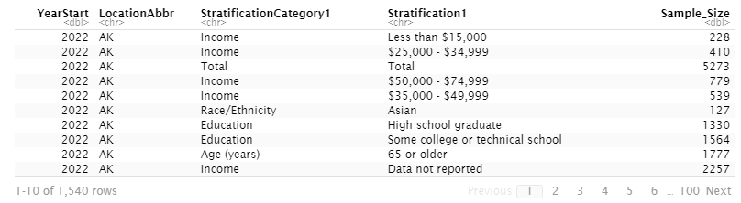
Our Datasets: Obesity
We discovered that the reason there were so many values, was because of a column called “StratificationCategory1” and “Stratification1”.
So, while they had the total value for one specific region/year, they also broke that up into different categories that they were looking at smaller groups (Age, Income, Education, Race/Ethnicity, etc.).

Slide 5
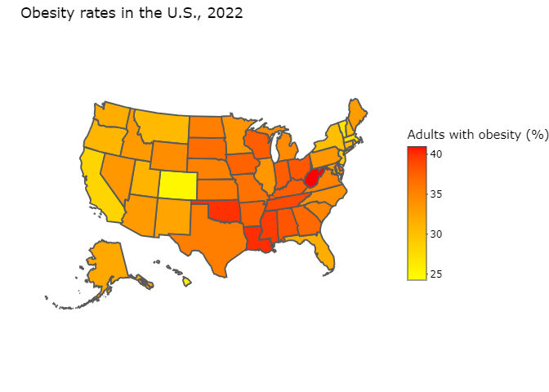
Basic Visualization from Obesity Data

Slide 6
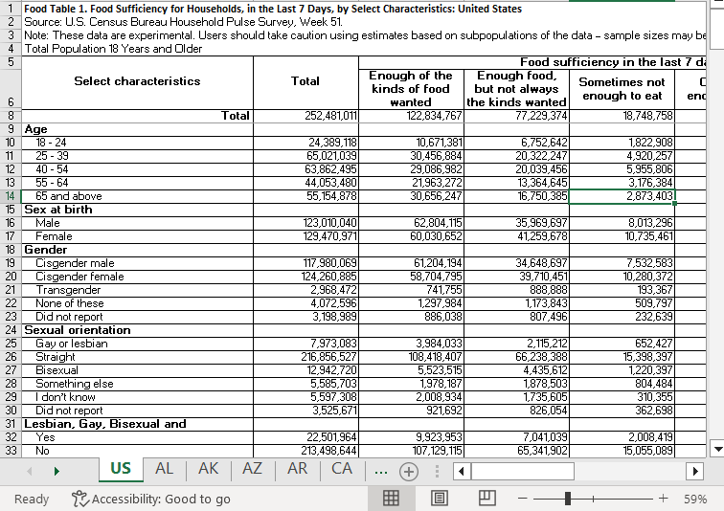
Our Datasets: Food Sufficiency
This data set was published by the United States Census Bureau.
They are looking at different food sufficiency levels for households while also considering other characteristics.
There was both state-by-state and national data.
The data spanned from 2020-2024.

Slide 7
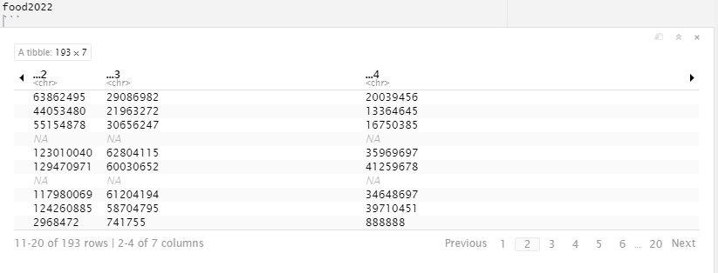
Our Datasets: Food Sufficiency
Some problems with this data set:
The way it is formated makes it very hard to convert into something that would be easy to use in R, requiring a lot of data wrangling.
The are separate excel files for each year, and within each file there are separate pages for each state.

Slide 8
Potential Research Question
How does the prevalence of obesity vary among states with different levels of food sufficiency in the United States?
We could look at other factors that could contribute to this from the Food Sufficiency and Obesity Data since they both have so many variables.
We could look at things like the contribution of income level or age.

Slide 9
Next Steps
We will look at the GitHub repository for the Household Pulse Survey: Measuring Emergent Social and Economic Matters Facing U.S. Households and try to recreate the analyses/report from it.
That will give us some starting point/example on how to tackle our data from the same survey and we can use it as a template.
From that we will try to tidy the Food Sufficiency data.

